Slide 1


Machine Learning Project Overview
Predicting Navigational Status of Vessels
by Peter

Slide 2
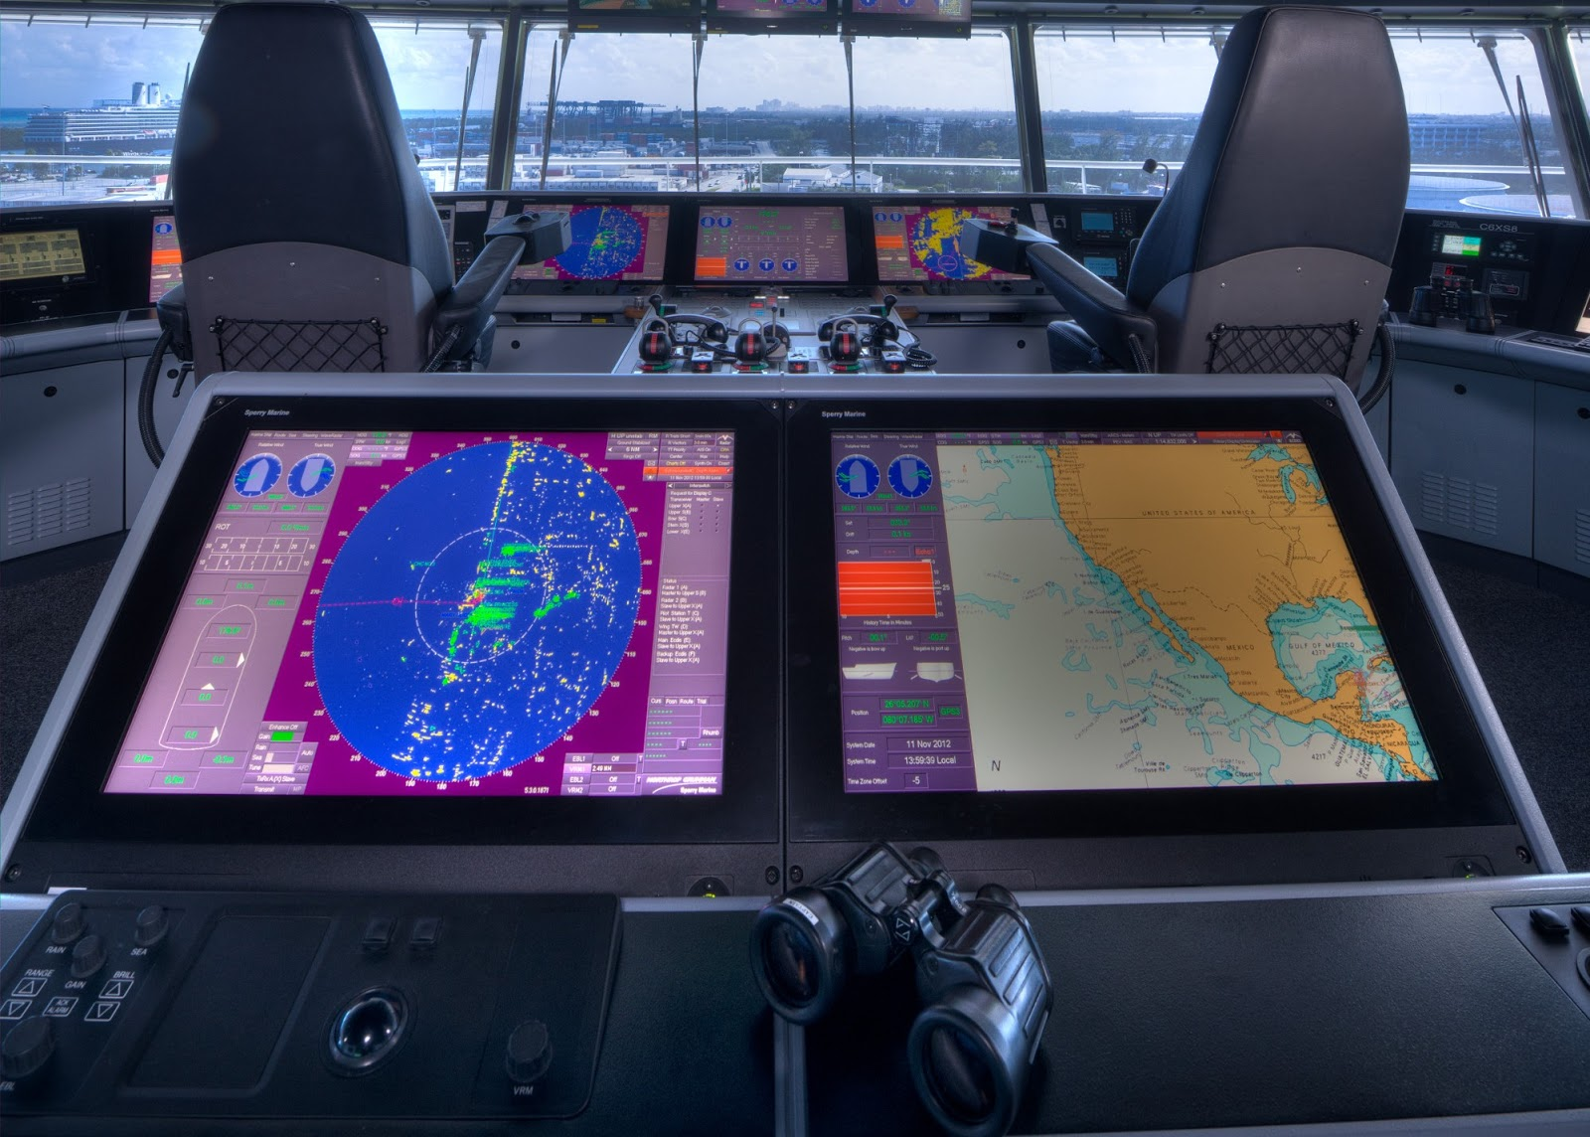
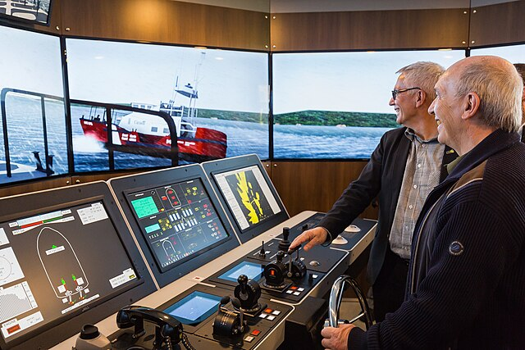
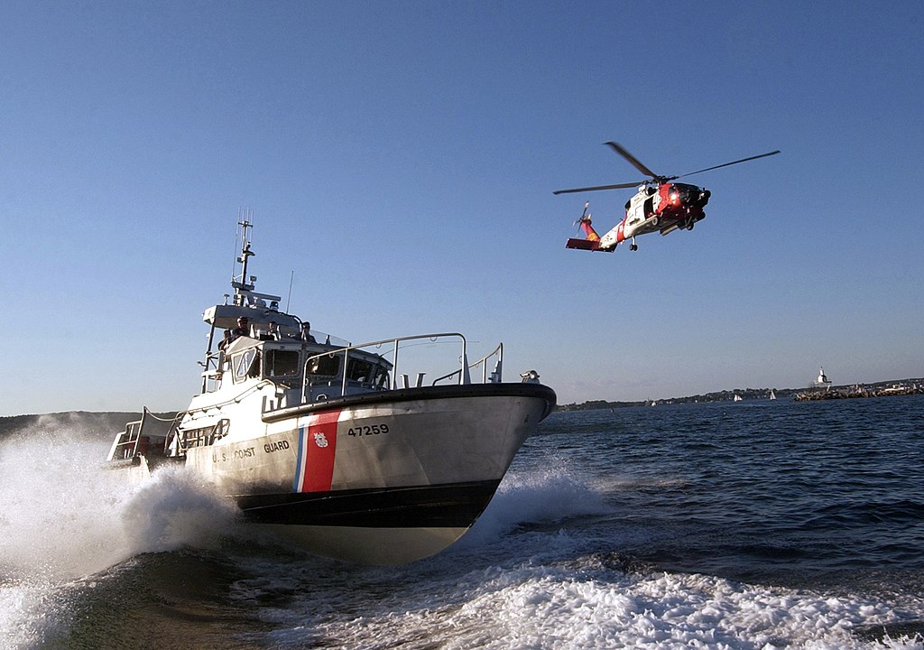
Introduction
AIS Data for Vessel Classification
Applications
Purpose: Train models to predict and analyze vessel behavior using large quantities of AIS data. Tasks include status prediction, path forecasting, and movement analysis.
Purpose: Train models to predict and analyze vessel behavior using large quantities of AIS data. Tasks include status prediction, path forecasting, and movement analysis.
Purpose: Train models to predict and analyze vessel behavior using large quantities of AIS data. Tasks include status prediction, path forecasting, and movement analysis.
Applications: Safety/security (e.g., illegal fishing detection, early warnings) Providing insights for mariners Simulating realistic vessel behavior in traffic models.
Focus in this project: Binary classification between fishing and underway using engine.

Slide 3

Literature Review
1
Kaggle - AI in Maritime Industry
2
Article - Ship Behavior Prediction
Predict ship types using AIS data. Methods include EDA, feature engineering, and LightGBM. Key insight: AIS data preprocessing and feature selection.
Predict trajectories with VRAE and sequence-to-sequence models. Key insight: Localized clustering improves predictive accuracy.
3
Fishing watch - Vessel Scoring
Detect fishing activities using heuristic and ML models. Key insight: Multi-window, gear-specific models enhance detection.
Please see the repository for full quotation and links.

Slide 4
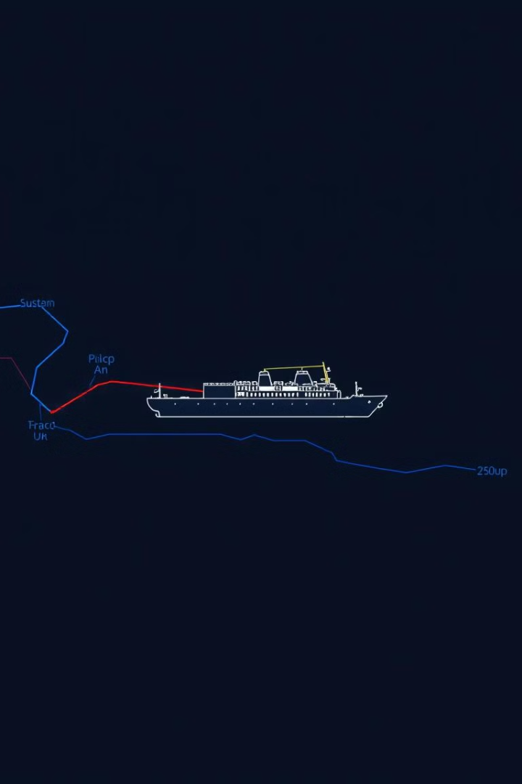
Dataset Characteristics
Grouped by vessel and filtered by area
Created time sets of equal navigational status
Grouped by vessel and filtered by area to ensure clarity (e.g., open sea vs. anchorage areas).
Created time sets of equal navigational status (e.g., 15 minutes or 2 hours).
Key features: Timestamp, Navigational Status (target), SOG, COG, Heading
Preprocessing steps included
Interpolating columns with less than 50% missing values.
Standardizing datasets to the same length and interval.
Subtracting the initial course from all COG and Heading values.
Cyclical encoding of circular values like COG and Heading.
Key features: Timestamp, Navigational Status (target), SOG, COG, Heading.

Slide 5
Baseline Model
Random Forest models were tested with
Tested on 15-minute and 2-hour sets
sequential and aggregated input
Accuracy ranged between 0.68 and 0.78, with some classes not recognized. Visualization and feature importance analysis helped understand the model's behavior.
all classes and with only 2 classes
Placeholder

Slide 6
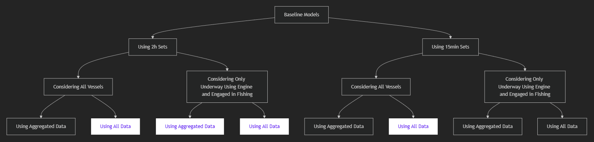
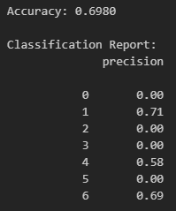
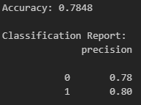
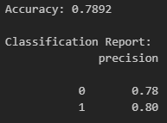
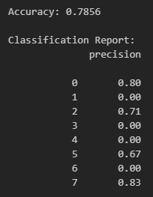
Baseline Model
⩯

Slide 7




Model Definition and Evaluation
LSTM models were developed to analyze time-series data
Challenges
Improvements
Challenges: At first only moderate results with positional data included. Poor results without positional data, even with class weights.
Improvements: Subtracting the initial course and cyclical encoding improved accuracy. Aggregating datasets into vectors for uniform time-slots showed better performance. Sliding window approach significantly enhanced accuracy (up to 0.99).
An LSTM model with a sliding window approach proved best. A lot of different approaches did not perform better that 0,8 accuracy.
(A curiosity is the computer vision CNN with binary classification of color-coded trajectories.)

Slide 8
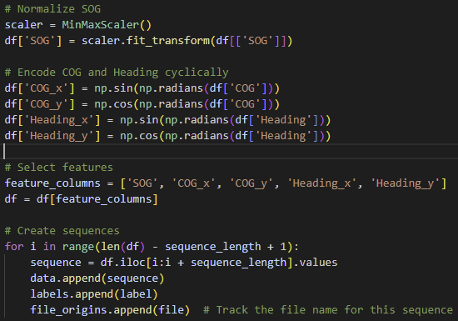
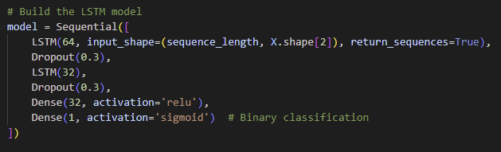
Model Definition and Evaluation

Slide 9

Evaluation and Results
99%
99%
Accuracy
Placeholder
Precision
98%
99%
Recall
F1 Score
Placeholder
Placeholder

Slide 10





Challenges and Errors
Data size
Standardization
Model architecture
Hyperparameter tuning
Dynamic time-slot modeling

Slide 11
Future Work
1
Expand to more vessel categories
2
Develop dynamic time-slot modeling
3
Incorporate additional features
4
Predict vessel movements

Slide 12
Image Sources
Introduction Slide:
1: https://2.bp.blogspot.com/-QYefxeGt3QE/V3fLHG7Bz_I/AAAAAAAAAGU/5CVK-aRw9nMmDivAB7Udm01jBJnz7x5OwCLcB/s1600/ecdis.jpg
2: https://upload.wikimedia.org/wikipedia/commons/thumb/2/2e/526C0940.jpg/640px-526C0940.jpg
3:

